Slide 1
Financial Accounting
IFRS 4th Edition
Weygandt ● Kimmel ● Kieso
Chapter 1
Accounting in Action

Slide 2
Chapter Preview
Good decision-making depends on good information.
Whatever your pursuits or occupation, the need for financial information is inescapable. You cannot earn a living, spend money, buy on credit, make an investment, or pay taxes without receiving, using, or dispensing financial information. Good decision-making depends on good information.

Slide 3
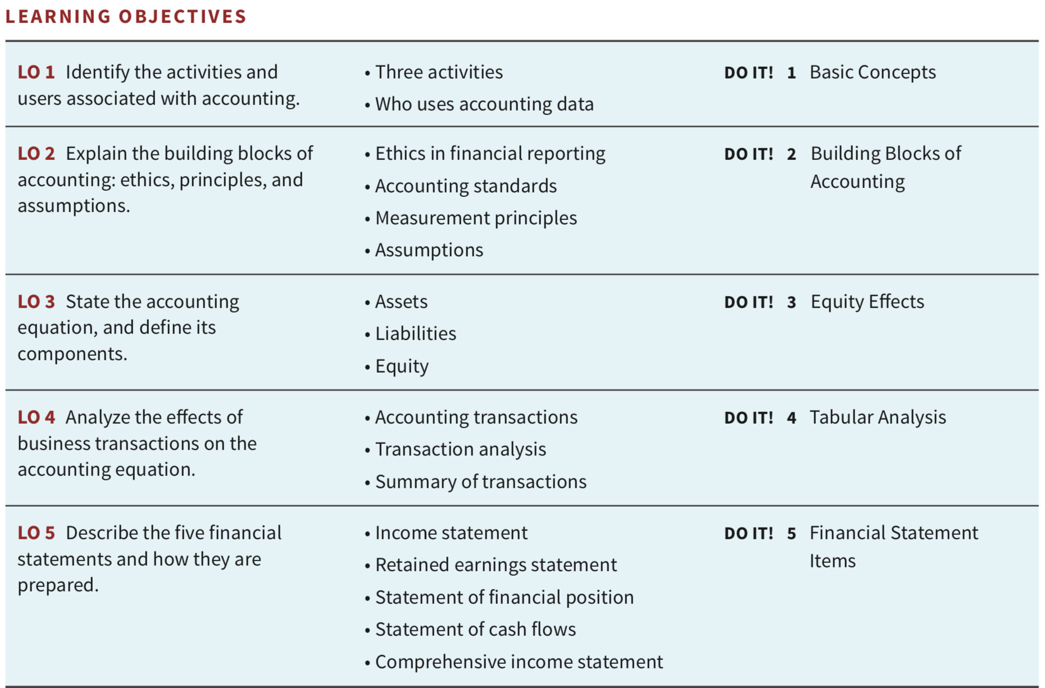
Chapter Outline

Slide 4
Learning Objective 1 Identify the activities and users associated with accounting.
LO 1

Slide 5
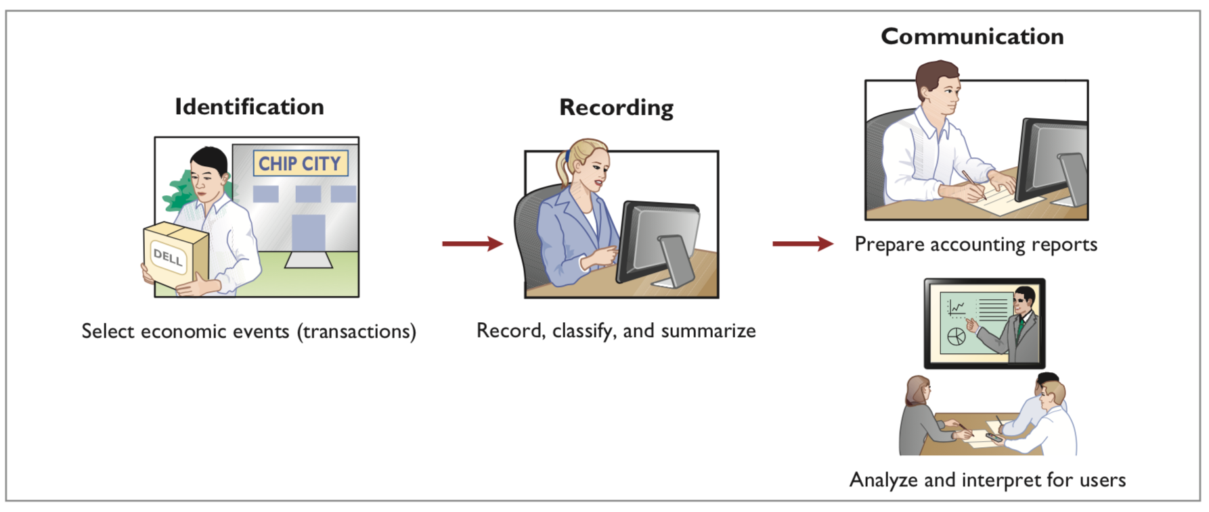
Accounting Activities and Users
Three Activities
LO 1

Slide 6
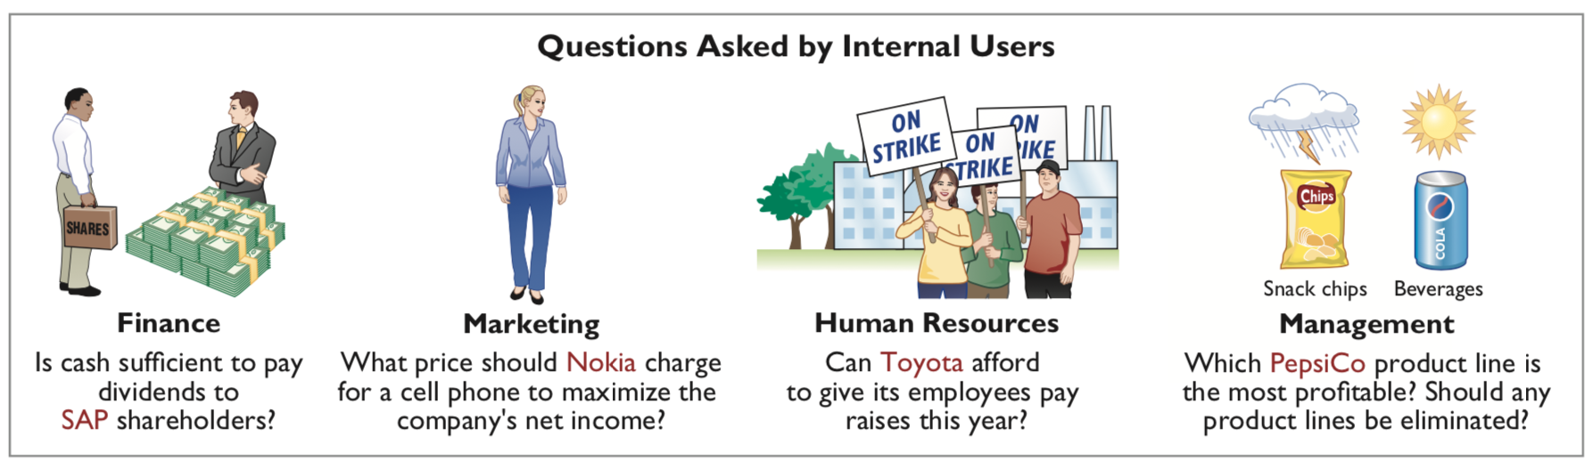
Accounting Activities and Users
Internal Users 내부사용자
LO 1

Slide 7


Accounting Activities and Users
External Users 외부사용자 (1/2)
LO 1

Slide 8
Accounting Activities and Users
External Users (2/2)
Taxing authorities: Does the company comply with the tax laws?
Regulatory agencies: Is the company operating within prescribed rules?
Labor unions: Does the company have the ability to pay increased wages and benefits to union members?
LO 1

Slide 9
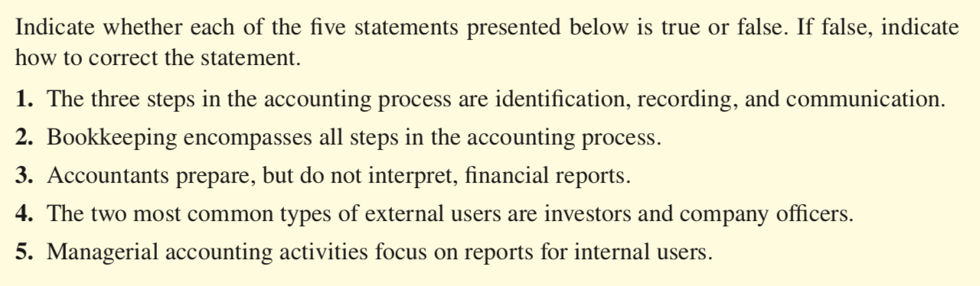
DO IT! Basic Concepts
ACTION PLAN
Review the basic concepts discussed.
Develop an understanding of the key terms used.
LO 4

Slide 10
DO IT! Basic Concepts Solution
True.
False. Bookkeeping involves only the recording step.
False. Accountants analyze and interpret information in reports as part of the communication step.
False. The two most common types of external users are investors and creditors.
True.
LO 4

Slide 11
Learning Objective 2 Explain the building blocks of accounting: ethics, principles, and assumptions.
LO 1

Slide 12
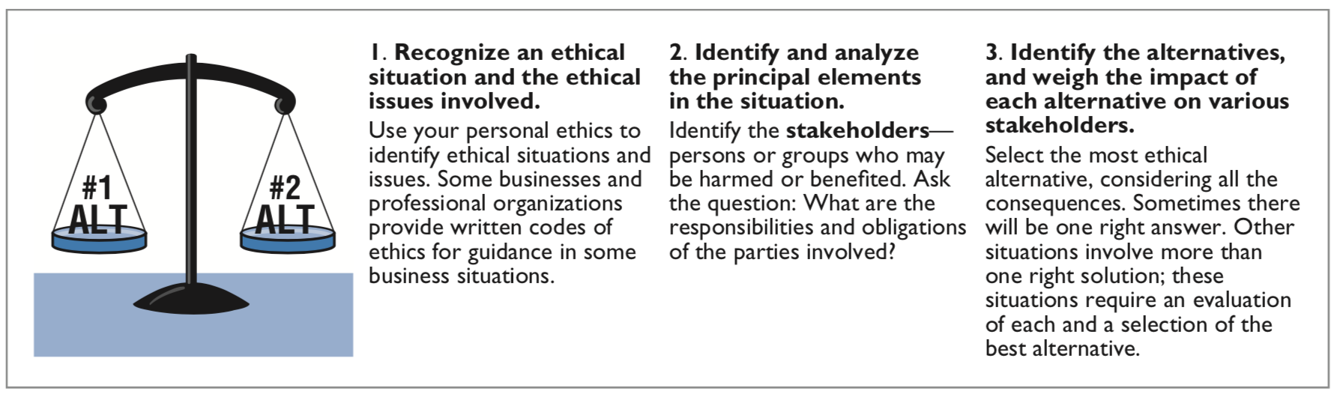
The Building Blocks of Accounting
Ethics in Financial Reporting
LO 2

Slide 13
The Building Blocks of Accounting
Accounting Standards
Ensure high-quality financial reporting.
Primary accounting standard-setting bodies:
International Accounting Standards Board (IASB)
Determines International Financial Reporting Standards (IFRS)
Used in 130 countries
Financial Accounting Standards Board (FASB)
Determines generally accepted accounting principles (GAAP)
Used by most companies in the U.S.
LO 2

Slide 14
The Building Blocks of Accounting
Measurement Principles
IFRS generally uses one of two measurement principles, the historical cost principle or the fair value principle.
Historical cost principle 역사적원가원칙 (or cost principle): dictates that companies record assets at their cost. This is true not only at the time the asset is purchased, but also over the time the asset is held.
Fair value principle 공정시장가치원칙: states that assets and liabilities should be reported at fair value (the price received to sell an asset or settle a liability).
LO 2

Slide 15
The Building Blocks of Accounting
Selecting Measurement Principles
Selection of which principle to follow generally relates to trade-offs between relevance and faithful representation.
Relevance 적절성 means that financial information is capable of making a difference in a decision.
Faithful representation 신뢰성 means that the numbers and descriptions match what really existed or happened—they are factual.
LO 2

Slide 16
The Building Blocks of Accounting
Assumptions
Assumptions provide a foundation for the accounting process. Two main assumptions are the monetary unit assumption and the economic entity assumption.
Monetary unit assumption 화폐단위의 가정: requires that companies include in the accounting records only transaction data that can be expressed in money terms.
Economic Entity Assumption 경제적실체의 가정: requires that the activities of the entity be kept separate and distinct from the activities of its owner and all other economic entities. Typical entity forms are proprietorship, partnership, corporation.
LO 2

Slide 17
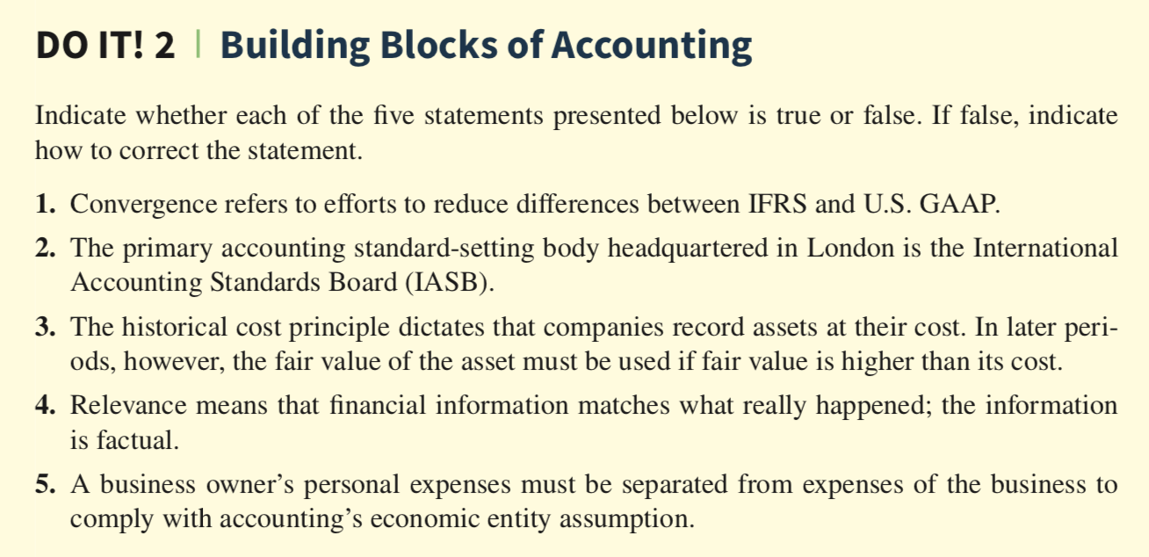
DO IT! Building Blocks of Accounting
ACTION PLAN
Review the discussion of ethics and financial reporting standards.
Develop an understanding of the key terms used.
LO 4

Slide 18
DO IT! Building Blocks of Accounting Solution
True.
True.
False. The historical cost principle dictates that companies record assets at their cost. Under the historical cost principle, the company must also use cost in later periods.
False. Faithful representation means that financial information matches what really happened; the information is factual.
True.
LO 4

Slide 19
Learning Objective 3 State the accounting equation 회계등식, and define its components.
LO 3

Slide 20

The Accounting Equation
The Basic Accounting Equation
Assets 자산: resources a business owns.
Liabilities 부채: claims against assets, i.e. existing debts and obligations.
Equity 자본: the ownership claim on a company’s total assets.
LO 3

Slide 21
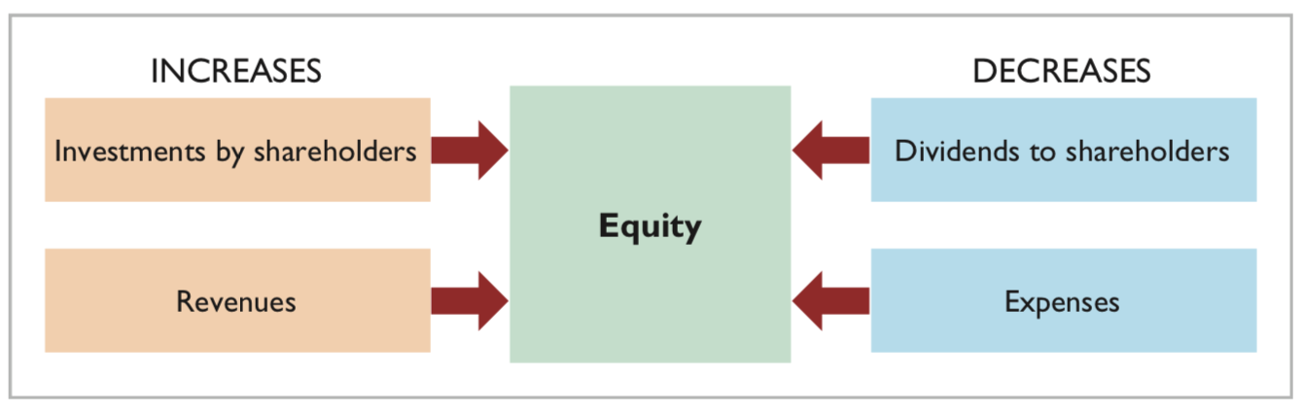
The Accounting Equation
Equity
Share capital—ordinary 주식자본: describes the amounts paid in by shareholders for the ordinary shares they purchase.
Revenues 매출: are the gross increases in equity resulting from business activities entered into for the purpose of earning income. Revenues usually result in an increase in an asset.
Expenses 비용: are the cost of assets consumed or services used in the process of earning revenue.
Dividends 배당금: are distribution of cash or other assets to shareholders. They are not an expense.
LO 3

Slide 22
DO IT! Equity Effects
Rent Expense
Service Revenue
Dividends
Salaries and Wage Expense
ACTION PLAN
Understand the sources of revenue.
Understand what causes expenses.
Review the rules for changes in equity: Investments and revenues increase equity. Expenses and dividends decrease equity.
Recognize that dividends are distributions of cash or other assets to shareholders.
LO 4

Slide 23
DO IT! Building Blocks of Accounting Solution
Rent Expense is an expense (E); it decreases equity.
Service Revenue is a revenue (R); it increases equity.
Dividends is a distribution to shareholders (D); it decreases equity.
Salaries and Wages Expense is an expense (E); it decreases equity.
LO 4

Slide 24
Learning Objective 4 Analyze the effects of business transactions 거래 on the accounting equation 회계등식.
LO 4

Slide 25
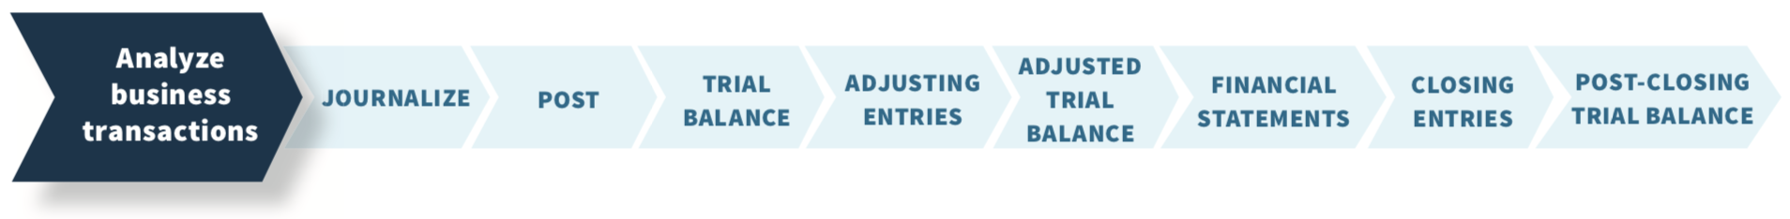
Analyzing Business Transactions
Accounting Information System:
The system of collecting and processing transaction data and communicating financial information to decision-makers.
The steps companies follow each period to record transactions and eventually prepare financial statements:
LO 4

Slide 26
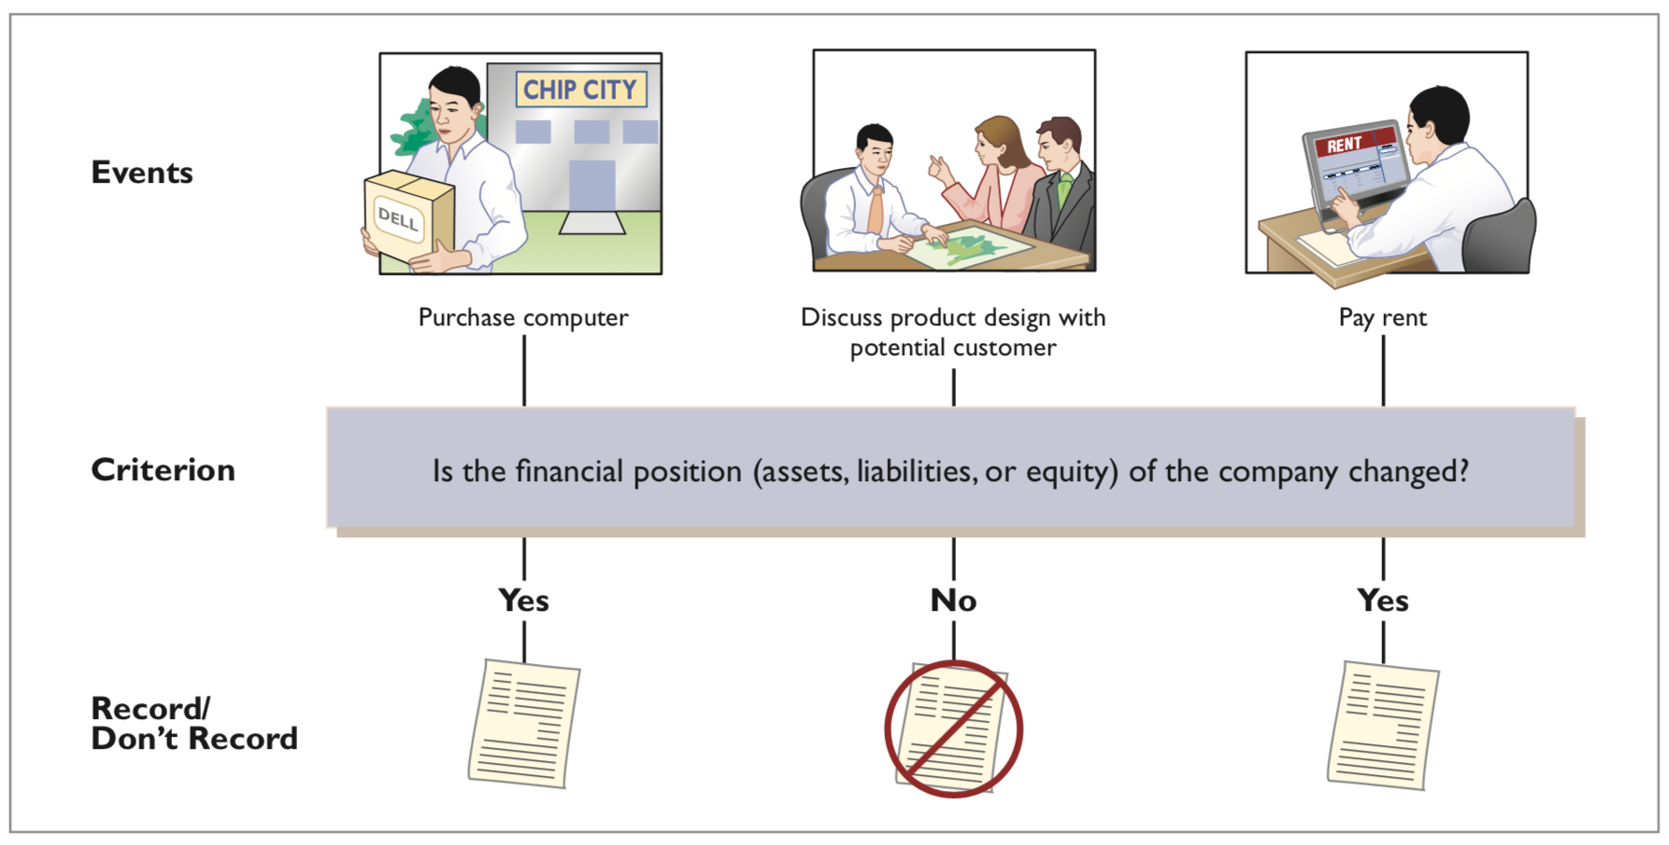
Analyzing Business Transactions
Identifying Accounting Transactions
LO 4

Slide 27
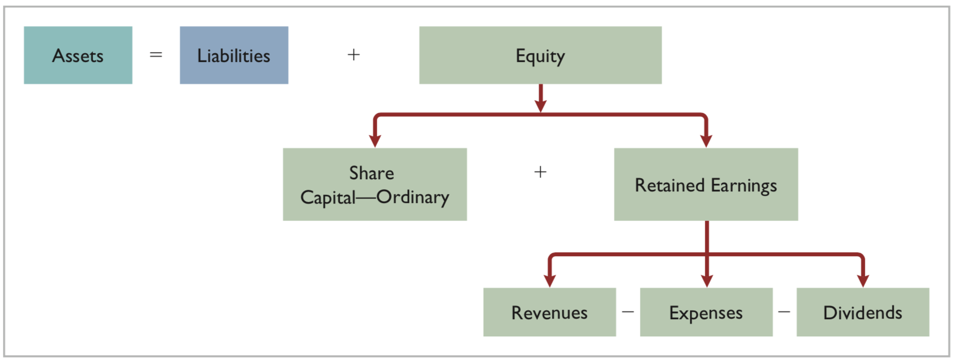
Analyzing Business Transactions
Expanding the Balance Sheet Equation for analysis
LO 4

Slide 28
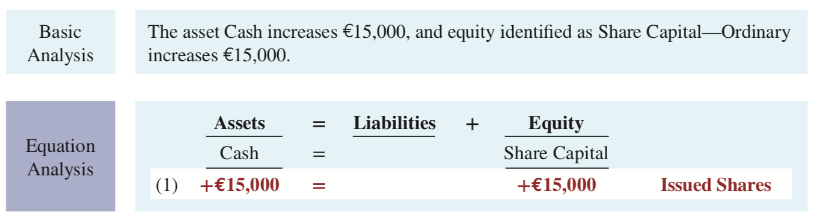
Transaction (1). Investment by Shareholders.
Assume: Ray and Barbara Neal decide to start a smartphone app development company that they incorporate as Softbyte SA. On September 1, 2020, they invest €15,000 cash in the business in exchange for €15,000 of ordinary shares. The ordinary shares indicates the ownership interest that the Neals have in Softbyte SA.
Demonstrate: Basic and equation analysis of this transaction.
Observe that the equality of the basic equation has been maintained. Note also that the source of the increase in equity (in this case, issued shares) is indicated.
LO 4

Slide 29
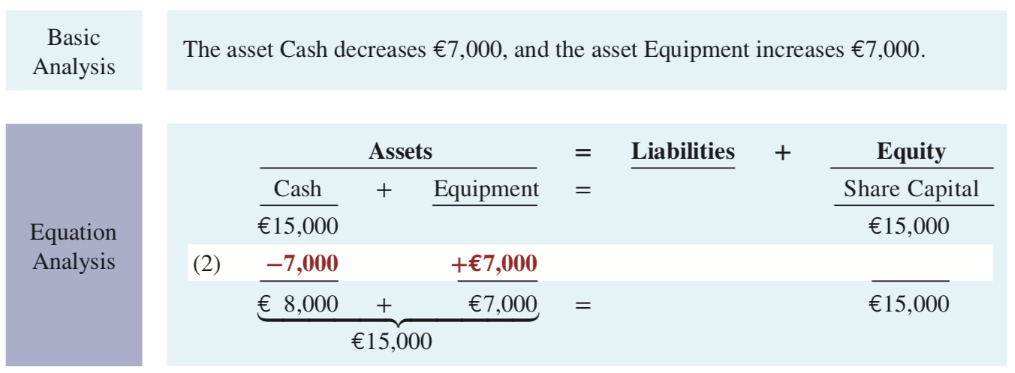
Transaction(2). Purchase of Equipment for Cash.
Assume: Softbyte SA purchases computer equipment for €7,000 cash.
Demonstrate: Basic and equation analysis of this transaction.
This transaction results in an equal increase and decrease in total assets, though the composition of assets changes.
LO 4

Slide 30
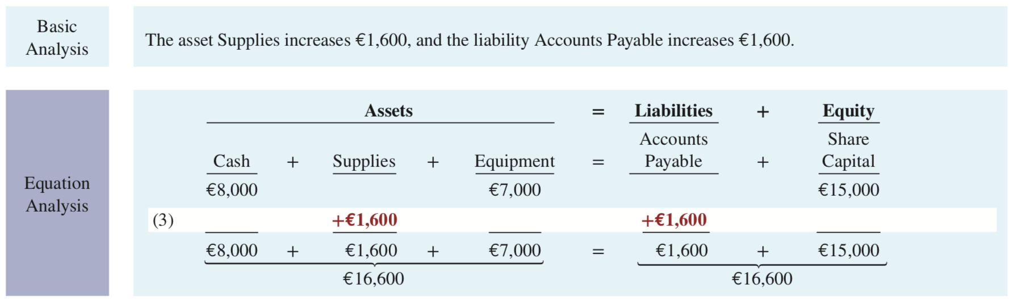
Transaction(3). Purchase of Supplies on Credit.
Assume: Softbyte SA purchases headsets (and other computer accessories expected to last several months) for €1,600 from Mobile Solutions. Mobile Solutions agrees to allow Softbyte to pay this bill in October. This transaction is a purchase on account (a credit purchase).
Demonstrate: Basic and equation analysis of this transaction.
Assets increase because of the expected future benefits of using the headsets and computer accessories, and liabilities increase by the amount due Mobile Solutions.
LO 4

Slide 31
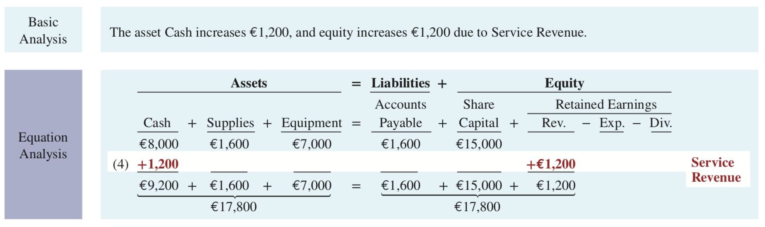
Transaction (4). Services Performed for Cash.
Assume: Softbyte SA receives €1,200 cash from customers for app development services it has performed. This transaction represents Softbyte’s principal revenue-producing activity. Recall that revenue increases equity.
Demonstrate: Basic and equation analysis of this transaction.
Recall that revenue increases equity.
LO 4

Slide 32
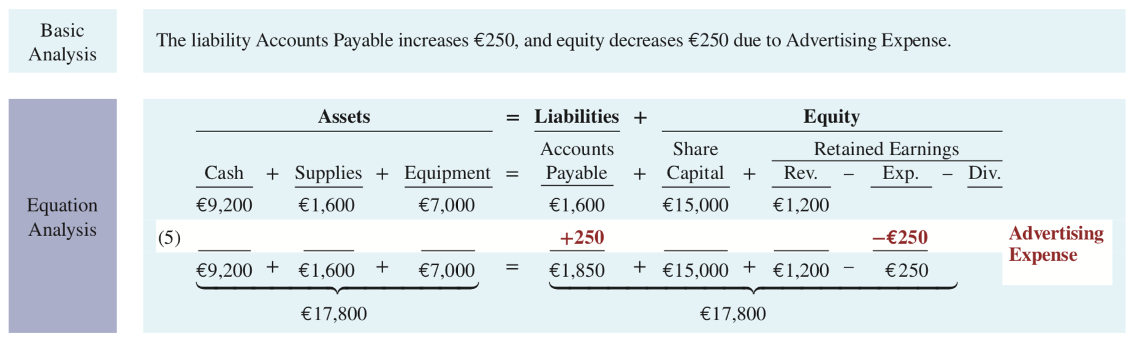
Transaction (5). Purchase of Advertising on Credit.
Assume: Softbyte SA receives a bill for €250 from Programming News for advertising on its website but postpones payment until a later date.
Demonstrate: Basic and equation analysis of this transaction.
The two sides of the equation still balance at €17,800. Retained Earnings decreases when Softbyte incurs the expense. Expenses do not have to be paid in cash at the time they are incurred.
When Softbyte pays at a later date, the liability Accounts Payable will decrease and the asset Cash will decrease [see Transaction (8)]. The cost of advertising is an expense (rather than an asset) because Softbyte has used the benefits. Advertising Expense is included in determining net income.
LO 4

Slide 33
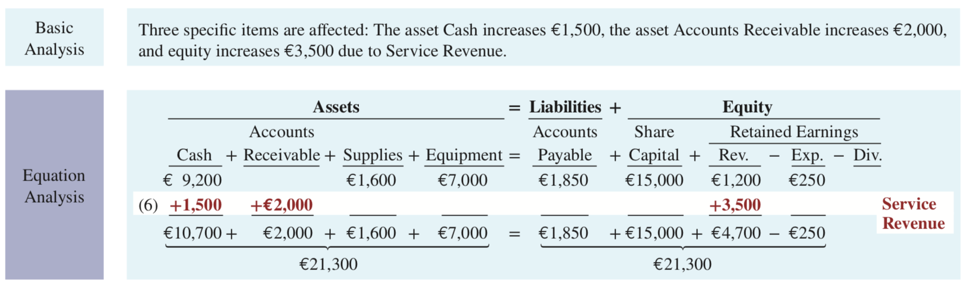
Transaction (6). Services Performed for Cash & Credit.
Assume: Softbyte SA performs €3,500 of app development services for customers. The company receives cash of €1,500 from customers, and it bills the balance of €2,000 on account.
Demonstrate: Basic and equation analysis of this transaction.
This transaction results in an equal increase in assets and equity.
LO 4

Slide 34
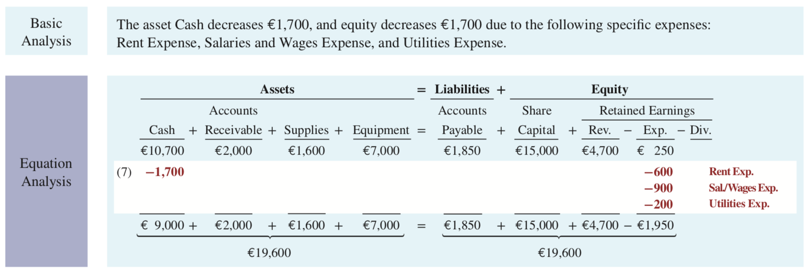
Transaction (7). Payment of Expenses.
Assume: Softbyte SA pays the following expenses in cash for September: office rent €600, salaries and wages of employees €900, and utilities €200.
Demonstrate: Basic and equation analysis of this transaction.
This transaction results in an equal decrease in assets and equity.
LO 4

Slide 35
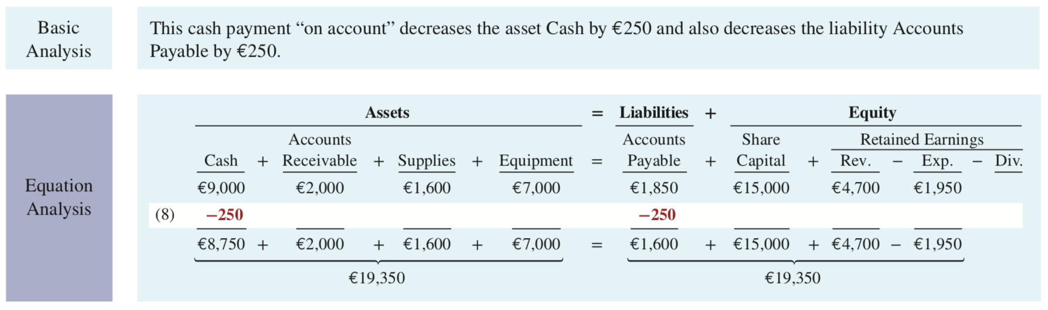
Transaction (8). Payment of Accounts Payable.
Assume: Softbyte SA pays its €250 Programming News bill in cash. The company previously [in Transaction (5)] recorded the bill as an increase in Accounts Payable and a decrease in equity.
Demonstrate: Basic and equation analysis of this transaction.
Observe that the payment of a liability related to an expense that has previously been recorded does not affect equity. Softbyte recorded the expense [in Transaction (5)] and should not record it again.
LO 4

Slide 36
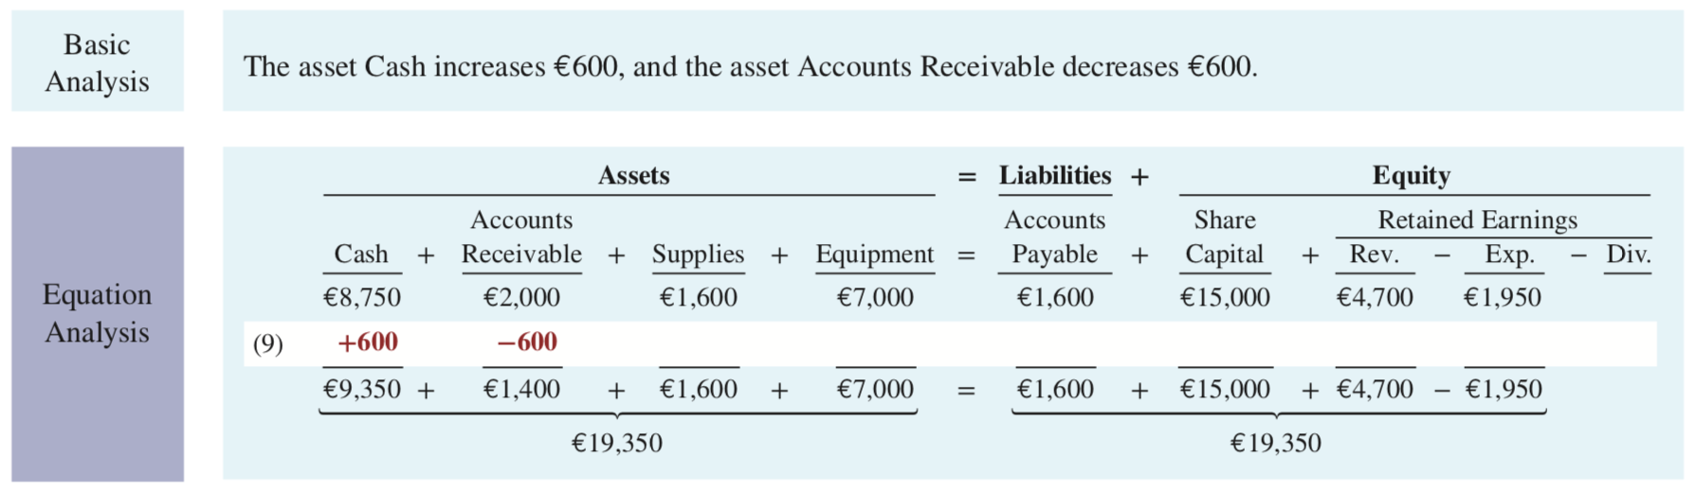
Transaction (9). Receipt of Cash on Account.
Assume: Softbyte SA receives €600 in cash from customers who had been billed for services [in Transaction (6)].
Demonstrate: Basic and equation analysis of this transaction.
Transaction (9) does not change total assets, but it changes the composition of those assets.
Note that the collection of an account receivable for services previously billed and recorded does not affect equity.
Softbyte already recorded this revenue [in Transaction (6)] and should not record it again.
LO 4

Slide 37
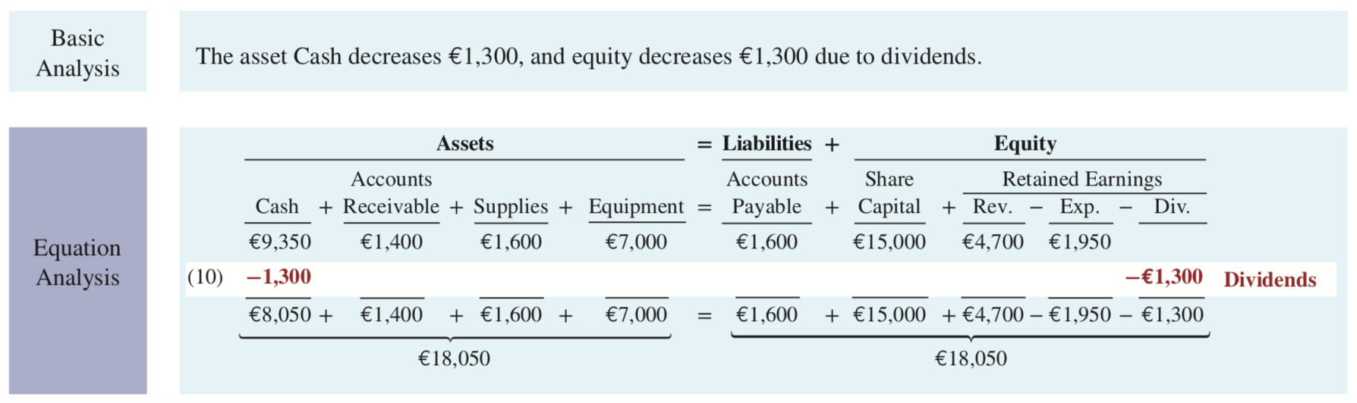
Transaction (10). Dividends.
Assume: The company pays a dividend of €1,300 in cash to Ray and Barbara Neal, the shareholders of Softbyte SA. This transaction results in an equal decrease in assets and equity.
Demonstrate: Basic and equation analysis of this transaction.
Transaction (9) does not change total assets, but it changes the composition of those assets.
Note that the dividend reduces retained earnings, which is part of equity. Dividends are not expenses.
Like shareholders’ investments, dividends are excluded in determining net income.
LO 4

Slide 38
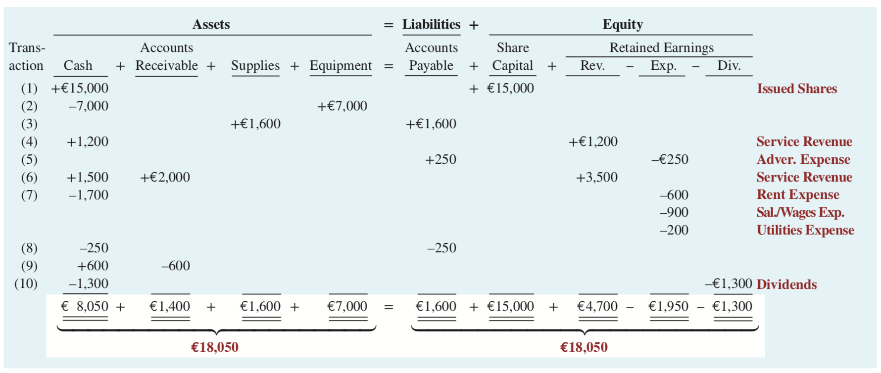
Softbyte SA: Tabular Analysis of Transactions
Analyzing Business Transactions
LO 4

Slide 39
Key Points
Analyzing Business Transactions
Each transaction must be analyzed in terms of its effect on:
a. The three components of the basic accounting equation.
b. Specific types (kinds) of items within each component.
The two sides of the equation must always be equal.
The Share Capital—Ordinary and Retained Earnings columns indicate the causes of each change in the shareholders’ claim on assets.
LO 4

Slide 40
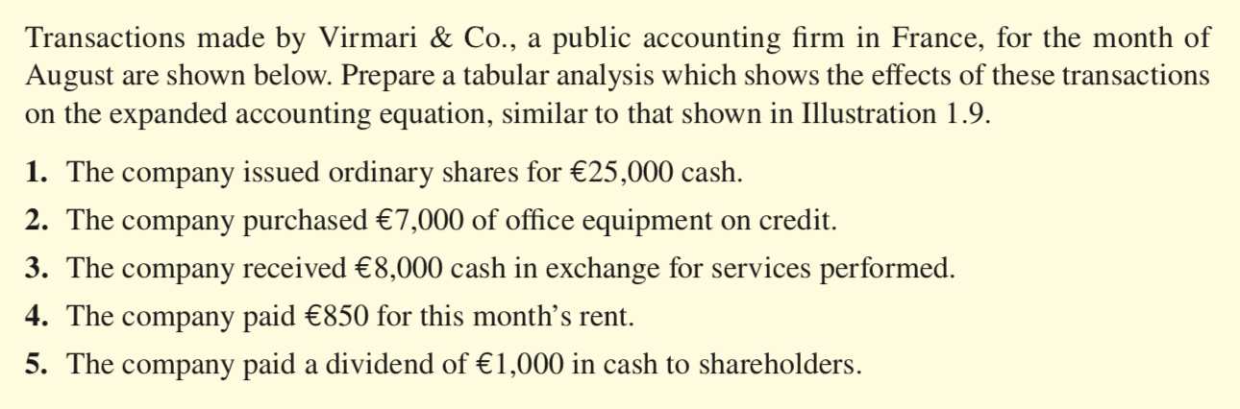
DO IT! Tabular Analysis
ACTION PLAN
Analyze the effects of each transaction on the accounting equation.
Use appropriate category names (not descriptions).
Keep the accounting equation in balance.
LO 4

Slide 41
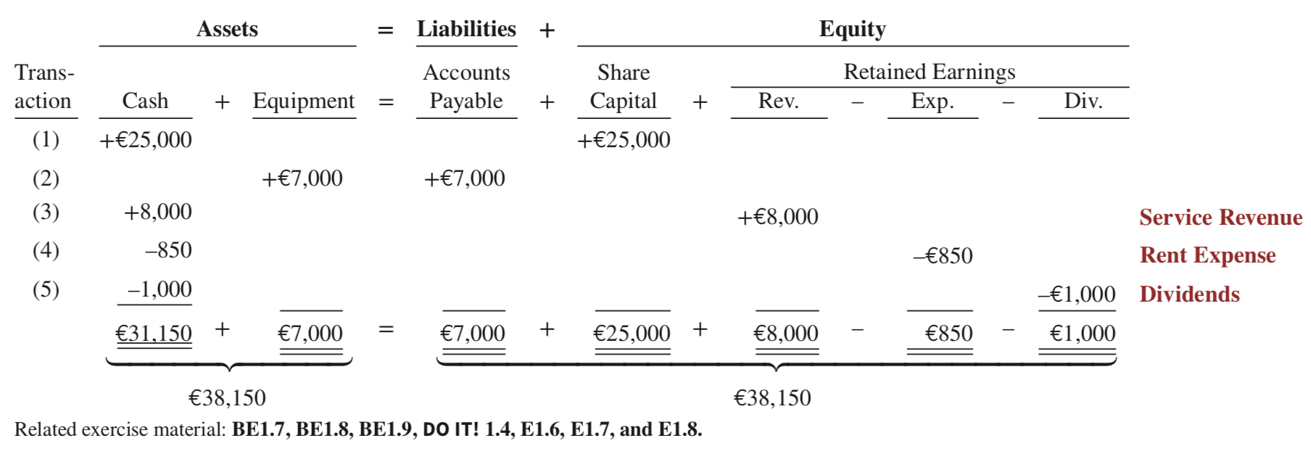
DO IT! Tabular Analysis Solution
LO 4

Slide 42
Learning Objective 5 Describe the five financial statements and how they are prepared.
LO 5

Slide 43
Companies prepare five financial statements from the summarized accounting data.
Financial Statements 재무제표
Income statement 손익계산서: presents the revenues and expenses and resulting net income or net loss for a specific period of time.
Retained earnings statement 잉여금계산서: summarizes the changes in retained earnings for a specific period of time.
Statement of financial position 재무상태표: reports the assets, liabilities, and equity of a company at a specific date. (Sometimes referred to as a balance sheet.)
Statement of cash flows 현금흐름표: summarizes information about the cash inflows (receipts) and outflows (payments) for a specific period of time.
Comprehensive income statement 포괄손익계산서: presents other comprehensive income items that are not included in the determination of net income in 1.
LO 5

Slide 44
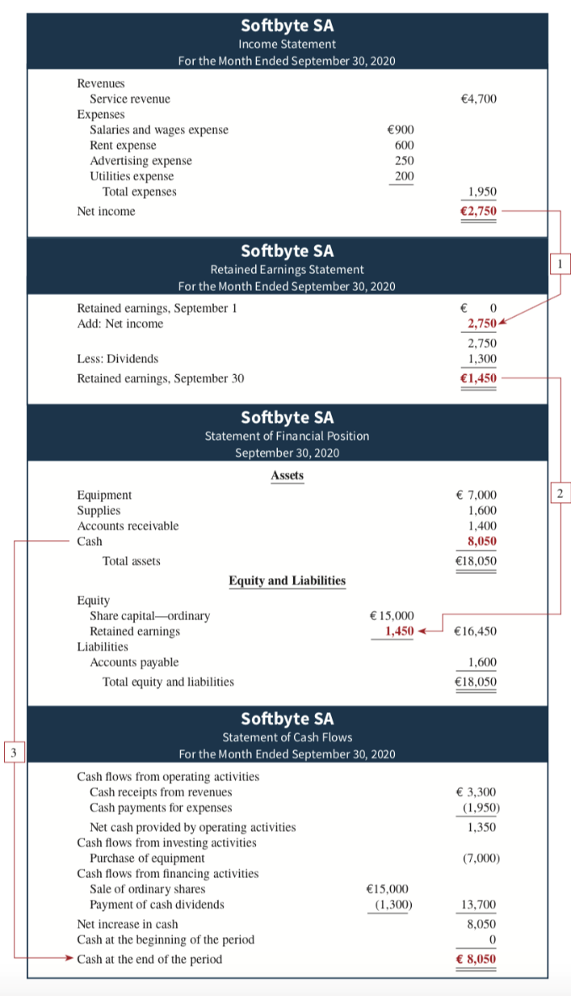
Financial Statement Connections
Income Statement
Net income is computed first and is needed to determine the ending balance in retained earnings.
Retained Earnings Statement
Statement of Financial Position
The ending balance in retained earnings is needed in preparing the statement of financial position.
The cash shown on the statement of financial position is needed in preparing the statement of cash flows.
Statement of Cash Flows
LO 5

Slide 45
Income Statement The income statement lists revenues first, followed by expenses. Then, the statement shows net income (or net loss).
Financial Statements
Structure:
The income statement lists revenues first, followed by expenses.
Then, the statement shows net income (or net loss).
When revenues exceed expenses, net income results.
When expenses exceed revenues, a net loss results.
The income statement does not include investment and dividend transactions between the shareholders and the business in measuring net income.
LO 5

Slide 46
Retained Earnings Statement The information provided by this statement indicates the reasons why retained earnings increased or decreased during the period. If there is a net loss, it is deducted with dividends in the retained earnings statement.
Financial Statements
Structure:
The first line of the statement shows the beginning retained earnings amount.
Then add net income (or subtract net loss) and subtract dividends.
The retained earnings ending balance is the final amount on the statement.
LO 5

Slide 47
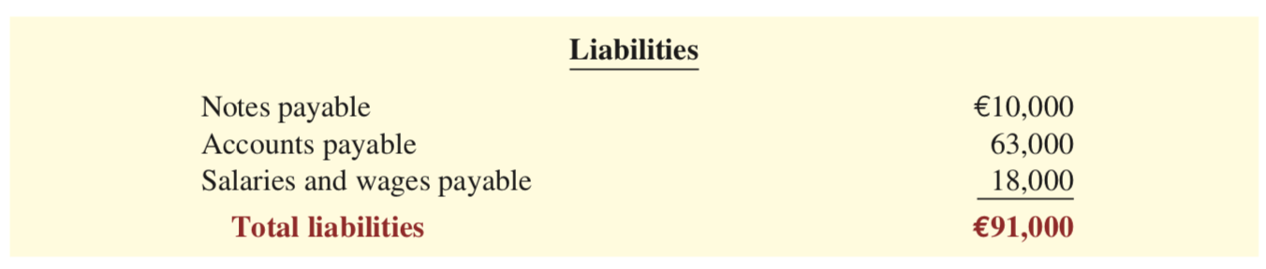

Statement of Financial Position The statement of financial position is like a snapshot of the company’s financial condition at a specific moment in time (usually the month-end or year-end). Structure: Lists assets at the top, followed by equity and then liabilities. Total assets must equal total equity and liabilities. When two or more liabilities are involved, a customary way of listing is as shown as follows:
Financial Statements
LO 5

Slide 48
Statement of Cash Flows The statement of cash flows provides information on the cash receipts and payments for a specific period of time.
Financial Statements
Structure:
The statement of cash flows reports
the cash effects of a company’s operations during a period,
its investing activities,
its financing activities,
the net increase or decrease in cash during the period, and
the cash amount at the end of the period.
LO 5

Slide 49
Comprehensive Income Statement Other comprehensive income items are not part of net income but are considered important enough to be reported separately. This statement immediately follows the income statement.
Financial Statements
IFRS Alternative:
IFRS allows an alternative statement format in which the information contained in the income statement and the comprehensive income statement are combined in a single statement, referred to as a statement of comprehensive income.
LO 5

Slide 50
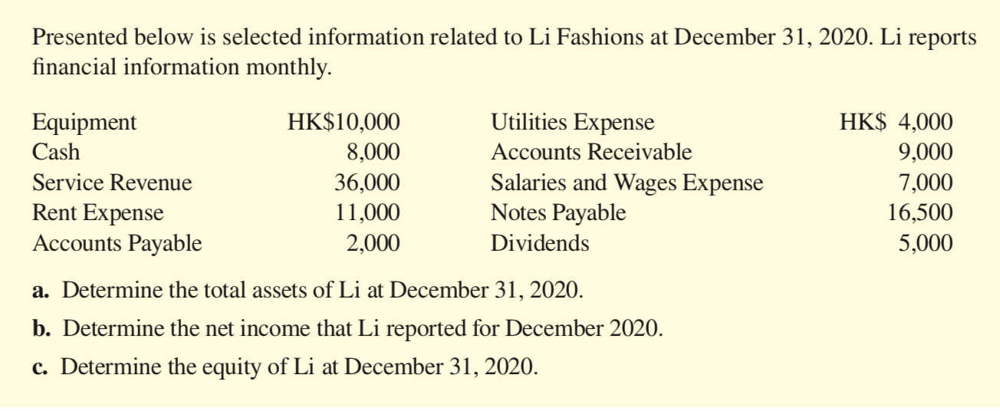
DO IT! Financial Statement Items
ACTION PLAN
Remember the basic accounting equation: assets must equal liabilities plus equity.
Review previous financial statements to determine how total assets, net income, and equity are computed.
LO 4

Slide 51
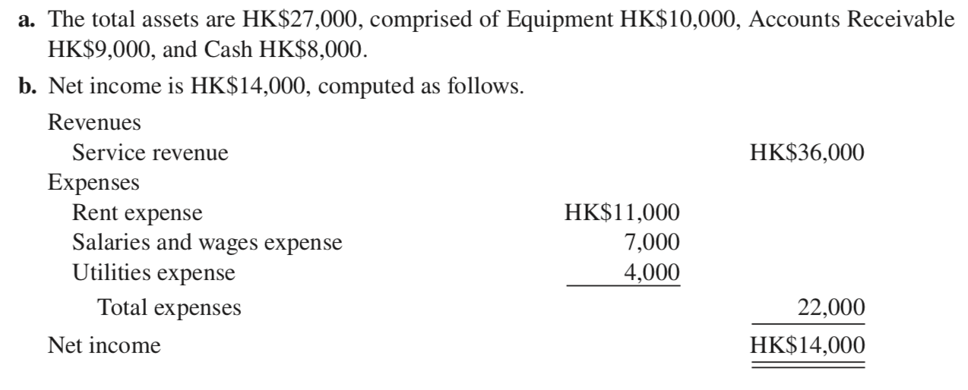
DO IT! Financial Statement Items Solution
LO 4

Slide 52
Why is accounting such a popular major and career choice? Public Accounting Individuals in public accounting offer expert service to the general public, in much the same way that doctors serve patients and lawyers serve clients. Choices: Auditing, taxation, management consulting Private Accounting Individuals in private accounting are employees of for-profit companies and not-for-profit organizations. Choices: Cost accounting, budgeting, accounting information system design and support, tax planning and preparation, internal auditing Governmental Accounting Choices: Tax authorities, local governments, law enforcement agencies, company regulators, accounting educators at public colleges and universities Forensic Accounting Choices: Investigate theft and fraud using accounting, auditing, and investigative skills
Career Opportunities in Accounting

Slide 53
Copyright
Copyright © 2019 John Wiley & Sons, Inc.
All rights reserved. Reproduction or translation of this work beyond that permitted in Section 117 of the 1976 United States Act without the express written permission of the copyright owner is unlawful. Request for further information should be addressed to the Permissions Department, John Wiley & Sons, Inc. The purchaser may make back-up copies for his/her own use only and not for distribution or resale. The Publisher assumes no responsibility for errors, omissions, or damages, caused by the use of these programs or from the use of the information contained herein.

